Slide 1

Department of Computer Science & Engineering(DATA SCIENCE)
MINI-PROJECT PRESENTATION
PROJECT NAME :-SWAP SHOP [E-commerce website]
PRESENTED BY:-
1) AADITYA PRAJAPATI
2) ANUJ MISHRA
3) Ganesh mohane
4) Yashwardhan pandey

Slide 2
FLOW OF PRESENTATION
1. Introduction
1.1 Motivation
1.2 Problem Statement
1.3 Objectives
2. Literature Survey
3. Proposed Methodology
4. Implementation
5. Result and Discussion
6. Conclusion and Future Scope
References

Slide 3

1. INTRODUCTION
What is swap shop?
Swap shop is an e-commerce website for the students, by the students.
Where students can just swap their stuffs online.
Students can sell their products at their satisfactory price or they can buy any products at their affordable price.

Slide 4
1. INTRODUCTION
1. MOTIVATION:-
In the first year, we wasted so much money and time because of buying and searching for new books just for 2-3 months of semesters.
Every student has old books and stationaries, which they can sell. e.g. Semesters books, Engineering Graphics instruments.
The motivation behind making this website is to get students their study materials at an affordable price and that too online.
So, from this, we got the motivation to build this E-commerce website for college students.

Slide 5
1. INTRODUCTION
2 . PROBLEM STATEMENT:-
Price of the Books are not affordable at times.
It can be time consuming to find certain books at times.
Unavailability of University recommended Books.
Limited time of library.

Slide 6
1. INTRODUCTION
3 . OBJECTIVE:-
Our Objective is to build an E-Commerce website where user can buy any study material in affordable price and can sell their study materials easily.

Slide 7
2. LITERATURE SURVEY
AUTHORS | TITLE OF THE PAPER | JOURNAL/CONFERE-NCE | YEAR | SUMMARY
Dr.Ravi.B. | E-Commerce-:Problems and Prospects | International Research Journal of Commerce Arts and Science(CASIJR) | 2021 | This research paper is about ecommerce, where author is explaning what is e-commerce and its advantage, disadvantages.
Mohammed Thabit | Building and Developing E-commerce Website | International Journal of Science and Research (IJSR). | 2017 | The aim of this paper is to build and develop a reliable website based on the e-commerce theories, developing effective well designed web pages.

Slide 8
2. LITERATURE SURVEY
GAPS IDENTIFIED:-
User can’t sell their Product.
Not user friendly.
The ideas used here are huge and not so friendly for students.
The prices are same as market.

Slide 9
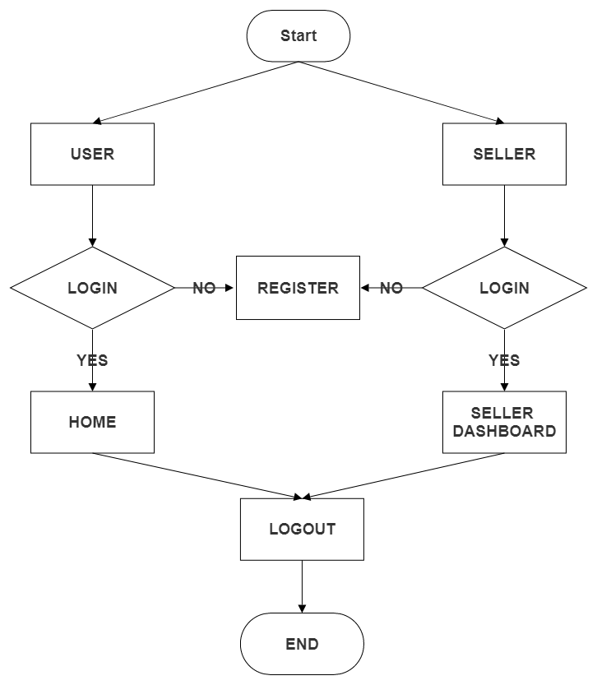
3. PROPOSED METHODOLOGY
FLOWCHART:-

Slide 10
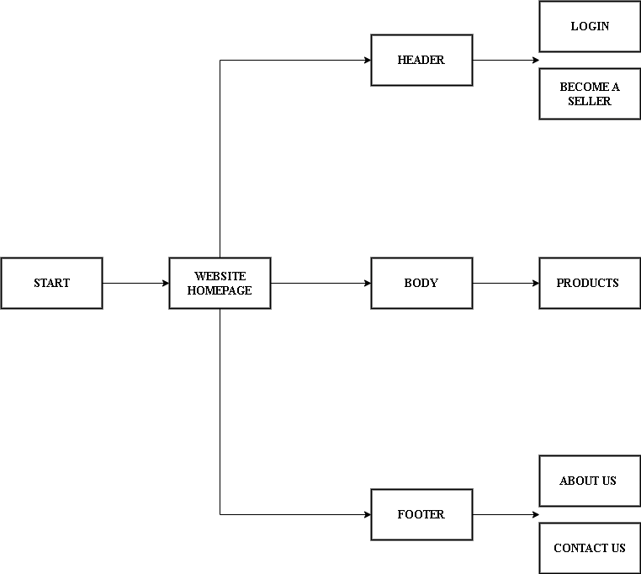
3. PROPOSED METHODOLOGY
BLOCK DIAGRAM:-
SEARCH BAR
CART

Slide 11
4.IMPLEMENTATION
FRONTEND:-
HARDWARE:-
1. HTML5
2. CSS
3. JS
1. PHP
2. MYSQL
1. PROCESSOR - 2 GHZ
2. RAM - 2GB
BACKEND:-
SOFTWARE:-
1. OS - WINDOWS
2. STORING OF CODE - GITLAB
3. TEXT EDITOR – VS-CODE

Slide 12
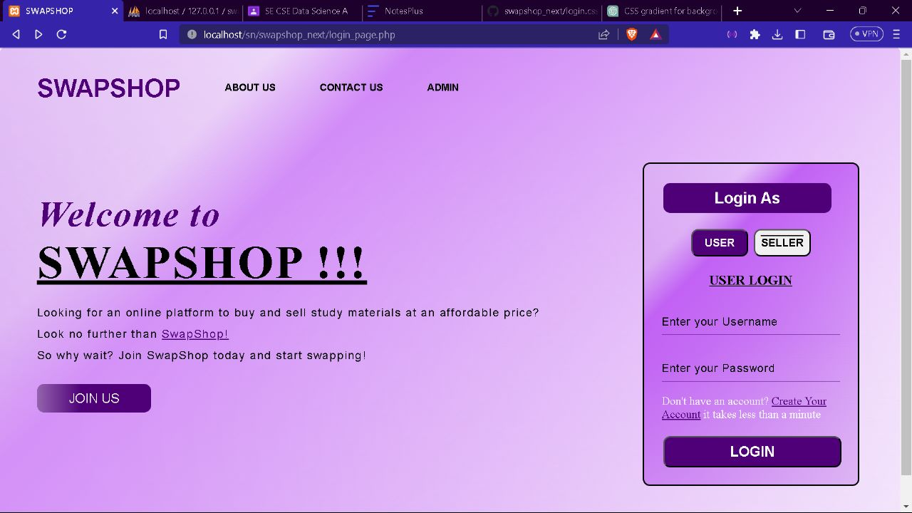
5. RESULT AND DISCUSSION

Slide 13
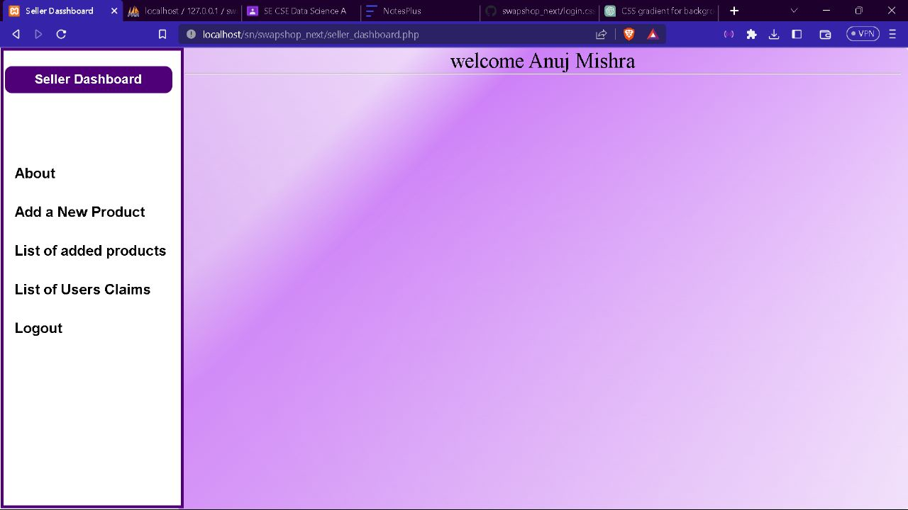
5. RESULT AND DISCUSSION

Slide 14
6.CONCLUSION & FUTURE SCOPE
CONCLUSION:-
As we have faced so many problems in the first year of the engineering regarding unavaibility of the stationaries, books, and other study materials.
So, we got the motivation of to build this SWAPSHOP website. After planning, researching we got the right result which we have expected.
So, I am concluding that now students can sell and buy their products through our website easily.
FUTURE SCOPE:-
WE WILL LAUNCH OUR SWAPSHOP APP.
ADD ONLINE PAYMENT SYSTEM.

Slide 15
REFERENCES
RESEARCH PAPERS :
[1] Dr.Ravi.B., E-Commerce-:Problems and Prospects,CASIJR Volume 8 Issue 6 [Year - 2021]
[2] Mohammed Thabit, Building and Developing E-commerce Website, IJSR Volume 3 Issue 9 [Year - 2017]
https://www.ijsr.net/
https://www.researchgate.net/
https://www.cajsir.net/
REFERENCE LINK:
https://www.Wikipedia.org
https://www.Slideshare.net
https://www.youtube.com

